Slide 1
ARNE Sublunarean Explorer: Lander Design
Researcher: Victor Hernandez
Mentor: Jekan Thanga
Collaborators: Mark Robinson, Robert Wagner, Francesco Testi
Abstract: http://www.hou.usra.edu/meetings/leag2014/pdf/3025.pdf

Slide 2

Arne Mission: Motivation
In-Situ Resource Utilization
Sustainable Lunar Bases
Human Exploration
Technological Advancement (faster, cheaper, safer)

Slide 3
Arne Mission: Challenges
Four Major Concerns:
Radiation
Micrometeorite Impacts
Extreme Temperature Swings
Outdated/Unproven Technologies

Slide 4
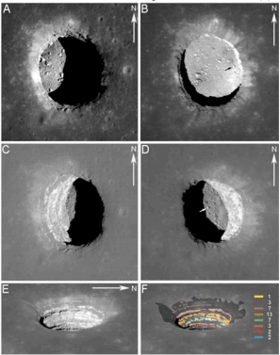
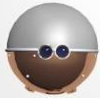
ARNE Mission: Goals
Determine feasibility of exploiting Mare Tranquilitatis Pit (MTP)
Technology demonstration of autonomous landing and pit bots
Investigation of lunar mare volcanism
Exploration of void
Morning
Noon
Annual Meeting of the Lunar Exploration Analysis Group, held 22-24 October, 2014 in Laurel, Maryland. LPI Contribution No. 1820, id.3025
Afternoon

Slide 5
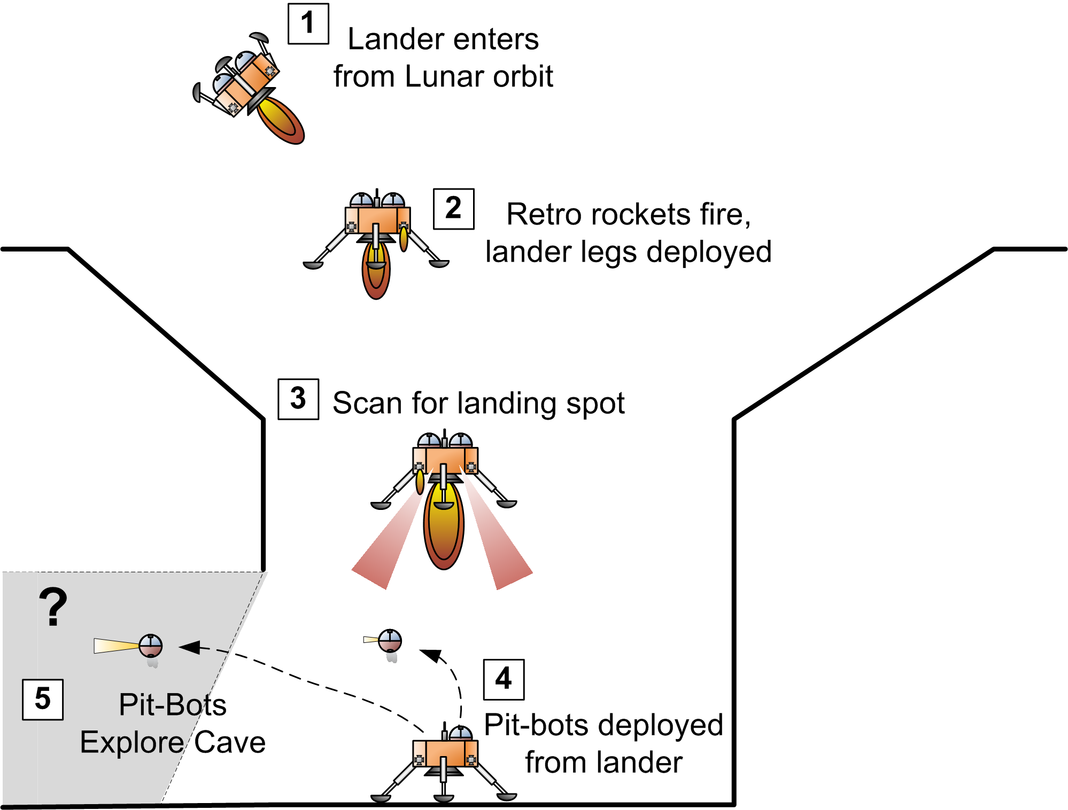

Slide 6
Power System

Slide 7
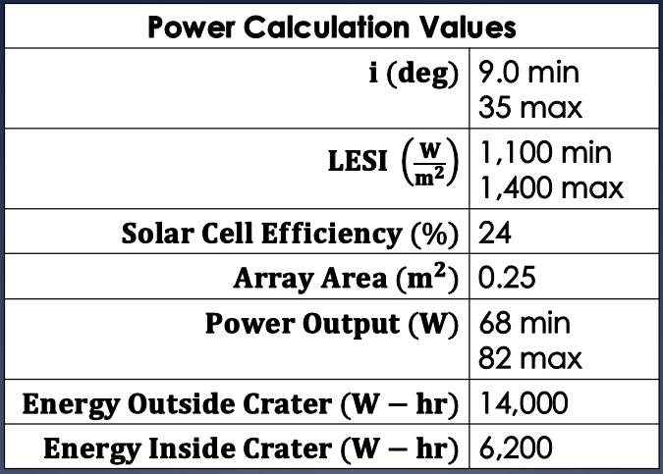
Power: Solar Panel Analysis
Suitability of solar panel power source
Feasibility of landing inside of Mare Tranquilitatis crater

Slide 8
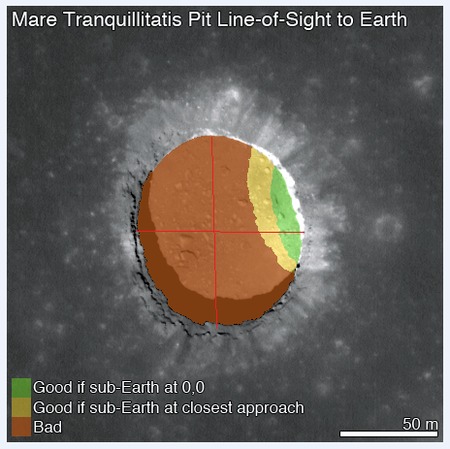
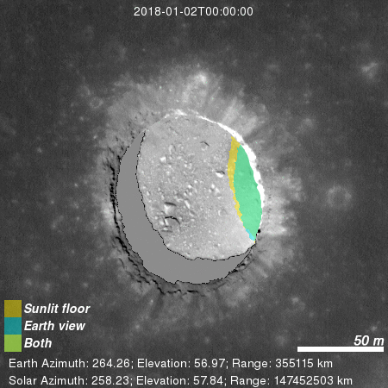
Power: Targeted Landing Site
Image Credit: Robert Wagner

Slide 9
Power: Conclusions
Solar panels are an acceptable power source
Crater landing feasible within target landing site
Targeted landing site large enough to accommodate off-nominal landing conditions

Slide 10
Structure

Slide 11
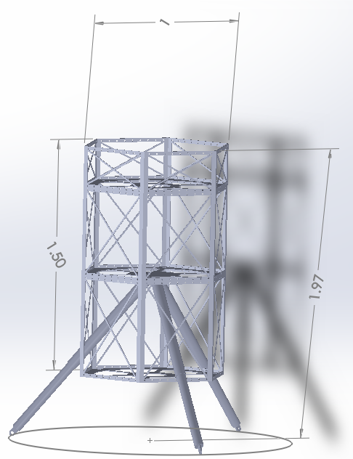
Structure: Design Overview
**Dimensions in meters**
Three Telescopic Legs
Hexagonal Shape
Sectioned into three tiers
Al 6061-T6 Material
Overall structural mass of 44 kg
Overall Structural Volume of 1.63 m²

Slide 12
Conclusions
Current design meets mission mass and volume requirements
Future small scale impact testing experiment will further validate design

Slide 13
Questions?

